Slide 1

QUIZ ONLINE

Slide 2





TEAM
Hồ Thế Bảo-22IT016
Võ Quốc Hoàng-22IT103

Slide 3

Why we chosse this topic
Table of content
Support tools
Demo website

Slide 4



1.Why we chosse this topic
-To help students study and learn. We have compiled multiple-choice test questions for subjects: math, physics, chemistry, and English on one website to make learning easy and fast.

Slide 5



2.Support tools
GITHUB
VSCODE

Slide 6
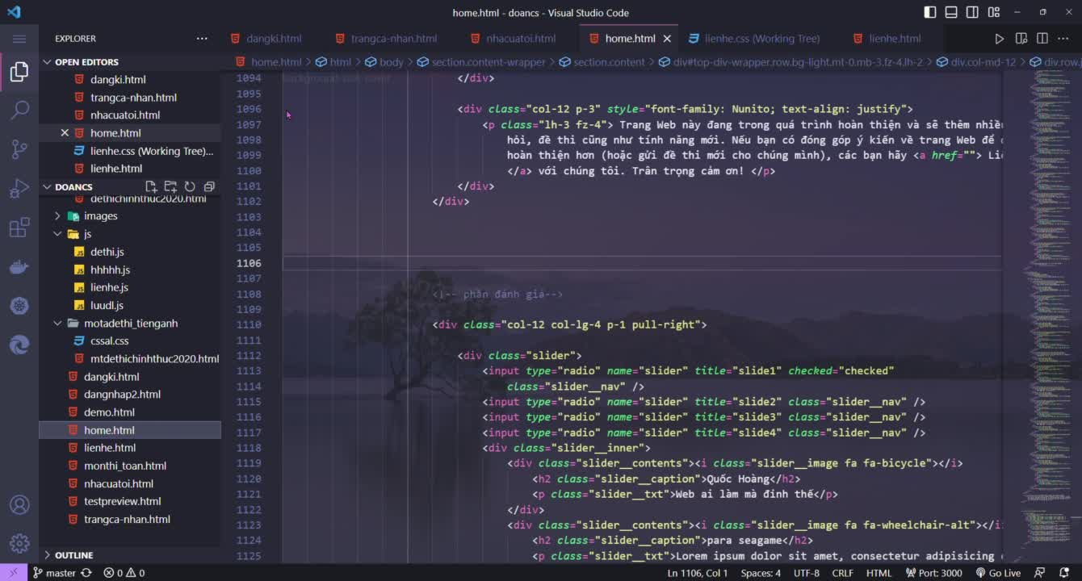
DEMO WEBSITE

Slide 7


